Slide 1
IEEE Central Texas Section
Spring Planning Meeting
January 21st, 2017
San Marcos, TX

Slide 2
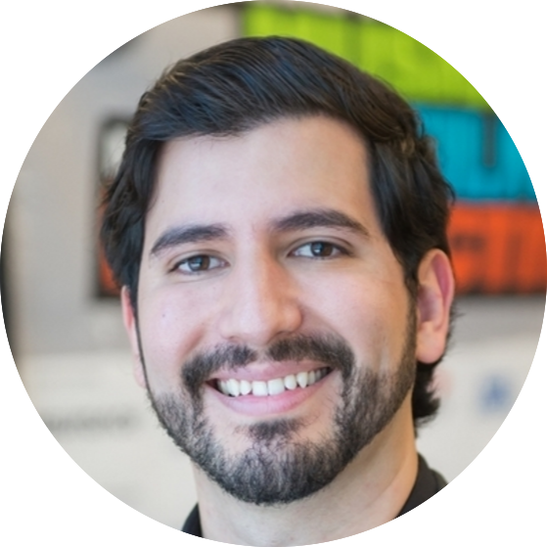
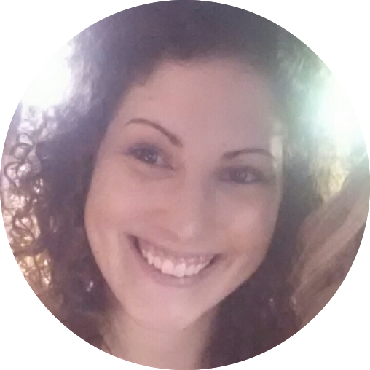
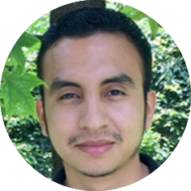
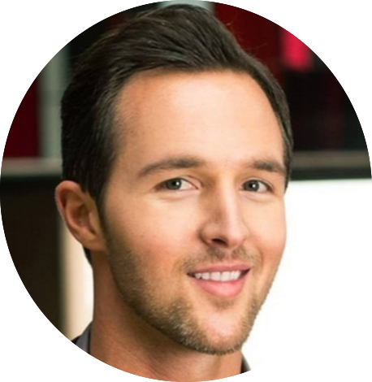
Leadership Team
Fabio Gomez
- Chair
Kathlene Hurt
- Outreach Chair
Gerardo Arias
- San Antonio Chair
Devon Ryan
- Past Chair
Notes:
Add member photos here

Slide 3
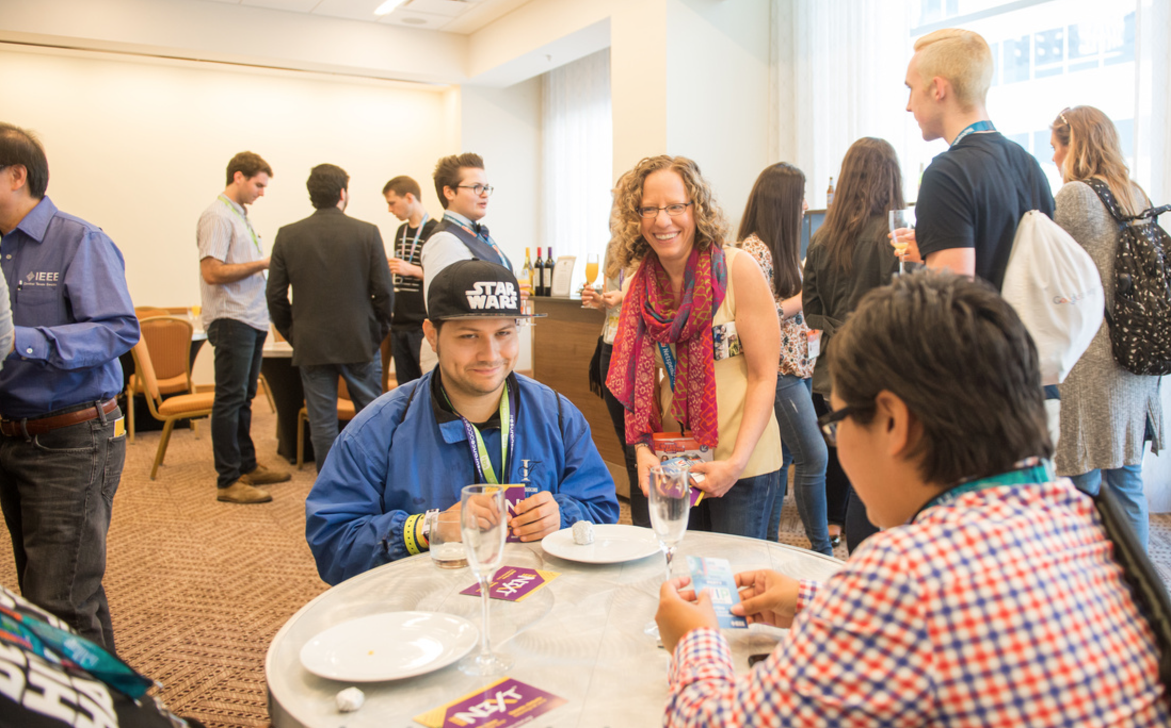
Notes:
Maybe create a slide for each bullet and add one photo
SXSW
Great networking and advertising for future events
FLF
It was a great (rather long) event
Definitely inspirational for young audience
It was good to bring industry veterans to show accomplishments and life in IEEE
It was also great to bring young successful Members to share their more relatable knowledge/experience with the young
Creative networking event that forced people to interact with each other. Made a lot of friends that way
Successful IEEE N3XT in Austin. Over 150 attendees
Strong Young Professionals and Student presence
It had 3 tracks. It was short and sweet
Had a Young Professionals reception right after, which was packed
Drove membership and volunteering opportunities
Lots of students
Started Monthly Networking events
About 15-20 attendees
They all liked the event!
They came to discover volunteering and networking opportunities
They liked the format and the time (Tuesday evening)
Gonna try new sponsors for every monthly event to keep things fresh
To attract newcomers and retain existing audience
Takeaways
To come prepared with contacts amongst other societies for networking
To come prepared with events they can volunteer for
To come prepared with flyers/cards for all the above

Slide 4
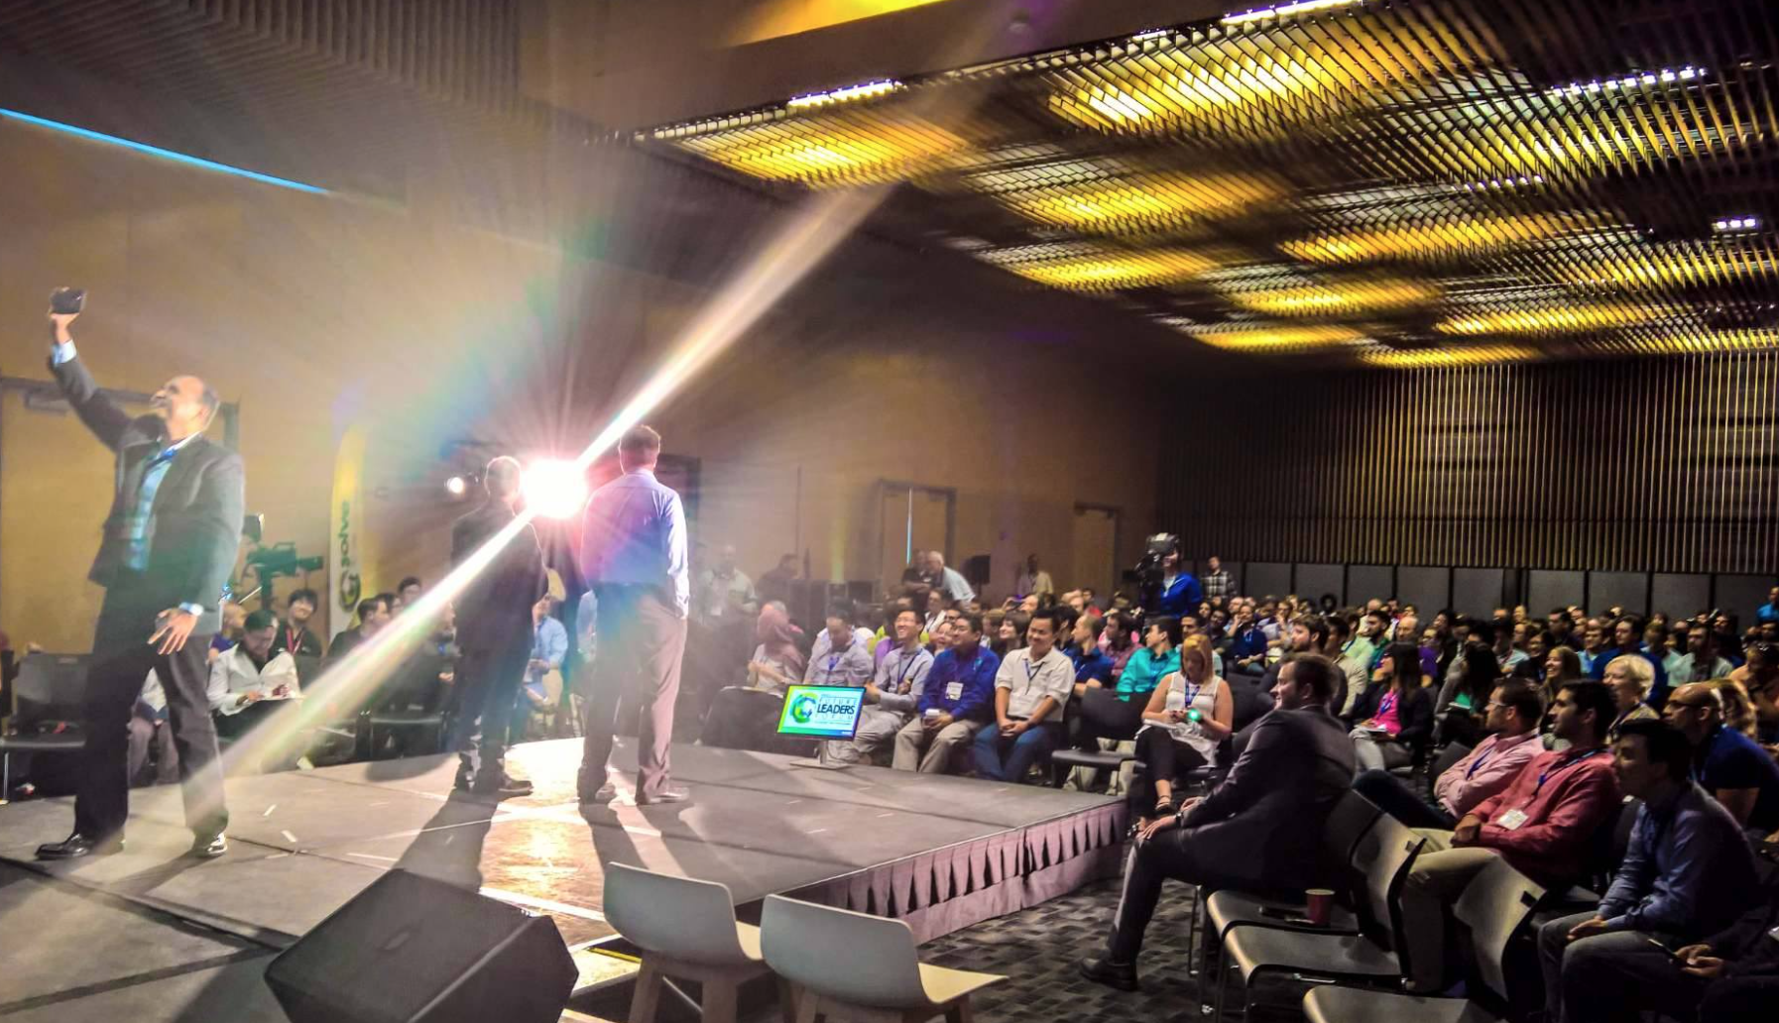
Notes:
Maybe create a slide for each bullet and add one photo
SXSW
Great networking and advertising for future events
FLF
It was a great (rather long) event
Definitely inspirational for young audience
It was good to bring industry veterans to show accomplishments and life in IEEE
It was also great to bring young successful Members to share their more relatable knowledge/experience with the young
Creative networking event that forced people to interact with each other. Made a lot of friends that way
Successful IEEE N3XT in Austin. Over 150 attendees
Strong Young Professionals and Student presence
It had 3 tracks. It was short and sweet
Had a Young Professionals reception right after, which was packed
Drove membership and volunteering opportunities
Lots of students
Started Monthly Networking events
About 15-20 attendees
They all liked the event!
They came to discover volunteering and networking opportunities
They liked the format and the time (Tuesday evening)
Gonna try new sponsors for every monthly event to keep things fresh
To attract newcomers and retain existing audience
Takeaways
To come prepared with contacts amongst other societies for networking
To come prepared with events they can volunteer for
To come prepared with flyers/cards for all the above

Slide 5
Notes:
Maybe create a slide for each bullet and add one photo
SXSW
Great networking and advertising for future events
FLF
It was a great (rather long) event
Definitely inspirational for young audience
It was good to bring industry veterans to show accomplishments and life in IEEE
It was also great to bring young successful Members to share their more relatable knowledge/experience with the young
Creative networking event that forced people to interact with each other. Made a lot of friends that way
Successful IEEE N3XT in Austin. Over 150 attendees
Strong Young Professionals and Student presence
It had 3 tracks. It was short and sweet
Had a Young Professionals reception right after, which was packed
Drove membership and volunteering opportunities
Lots of students
Started Monthly Networking events
About 15-20 attendees
They all liked the event!
They came to discover volunteering and networking opportunities
They liked the format and the time (Tuesday evening)
Gonna try new sponsors for every monthly event to keep things fresh
To attract newcomers and retain existing audience
Takeaways
To come prepared with contacts amongst other societies for networking
To come prepared with events they can volunteer for
To come prepared with flyers/cards for all the above

Slide 6
Notes:
Maybe create a slide for each bullet and add one photo
SXSW
Great networking and advertising for future events
FLF
It was a great (rather long) event
Definitely inspirational for young audience
It was good to bring industry veterans to show accomplishments and life in IEEE
It was also great to bring young successful Members to share their more relatable knowledge/experience with the young
Creative networking event that forced people to interact with each other. Made a lot of friends that way
Successful IEEE N3XT in Austin. Over 150 attendees
Strong Young Professionals and Student presence
It had 3 tracks. It was short and sweet
Had a Young Professionals reception right after, which was packed
Drove membership and volunteering opportunities
Lots of students
Started Monthly Networking events
About 15-20 attendees
They all liked the event!
They came to discover volunteering and networking opportunities
They liked the format and the time (Tuesday evening)
Gonna try new sponsors for every monthly event to keep things fresh
To attract newcomers and retain existing audience
Takeaways
To come prepared with contacts amongst other societies for networking
To come prepared with events they can volunteer for
To come prepared with flyers/cards for all the above

Slide 7
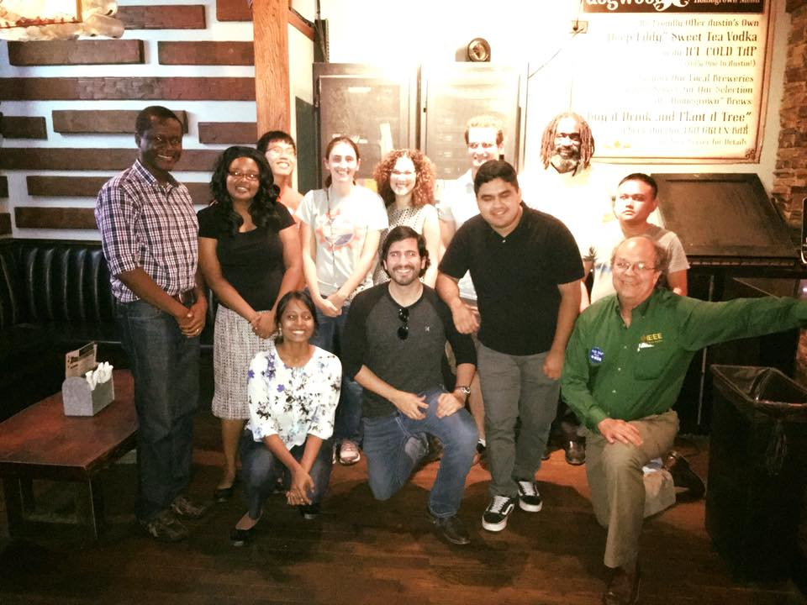
Notes:
Maybe create a slide for each bullet and add one photo
SXSW
Great networking and advertising for future events
FLF
It was a great (rather long) event
Definitely inspirational for young audience
It was good to bring industry veterans to show accomplishments and life in IEEE
It was also great to bring young successful Members to share their more relatable knowledge/experience with the young
Creative networking event that forced people to interact with each other. Made a lot of friends that way
Successful IEEE N3XT in Austin. Over 150 attendees
Strong Young Professionals and Student presence
It had 3 tracks. It was short and sweet
Had a Young Professionals reception right after, which was packed
Drove membership and volunteering opportunities
Lots of students
Started Monthly Networking events
About 15-20 attendees
They all liked the event!
They came to discover volunteering and networking opportunities
They liked the format and the time (Tuesday evening)
Gonna try new sponsors for every monthly event to keep things fresh
To attract newcomers and retain existing audience
Takeaways
To come prepared with contacts amongst other societies for networking
To come prepared with events they can volunteer for
To come prepared with flyers/cards for all the above

Slide 8
Notes:
Get IBM, Intel, SouthWest Research Institute
Some people looking for jobs
Some people are curious
Also bring someone from the company so they can network

Slide 9
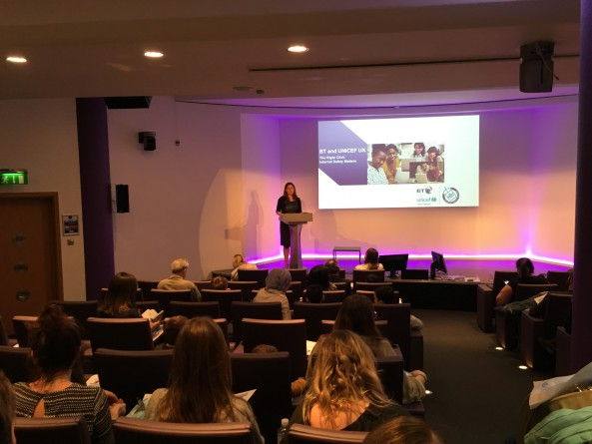
Notes:
This can help both young professionals and students

Slide 10
2016 Year Summary
IEEE YP Presence in SXSW (2 hot events)
IEEE YP Mimosa Meetup
IEEE Future of Identity After-Party
Co-organized MAW YP networking event
Fabio attended Future Leaders Forum @NOLA
Co-organized 1st IEEE N3XT 2016 in Austin
YP Networking Reception
Started Monthly Networking events
Recruiting leadership team
Grew social media presence (Facebook, Twitter, LinkedIn)
Notes:
Maybe create a slide for each bullet and add one photo
SXSW
Great networking and advertising for future events
FLF
It was a great (rather long) event
Definitely inspirational for young audience
It was good to bring industry veterans to show accomplishments and life in IEEE
It was also great to bring young successful Members to share their more relatable knowledge/experience with the young
Creative networking event that forced people to interact with each other. Made a lot of friends that way
Successful IEEE N3XT in Austin. Over 150 attendees
Strong Young Professionals and Student presence
It had 3 tracks. It was short and sweet
Had a Young Professionals reception right after, which was packed
Drove membership and volunteering opportunities
Lots of students
Started Monthly Networking events
About 15-20 attendees
They all liked the event!
They came to discover volunteering and networking opportunities
They liked the format and the time (Tuesday evening)
Gonna try new sponsors for every monthly event to keep things fresh
To attract newcomers and retain existing audience
Takeaways
To come prepared with contacts amongst other societies for networking
To come prepared with events they can volunteer for
To come prepared with flyers/cards for all the above

Slide 11
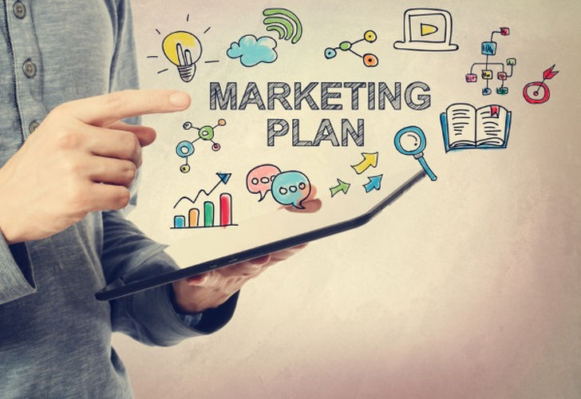
CTS Marketing & Goals

Slide 12
CTS Marketing & Goals
Create engagement channels for our Audience
Measure & Learn our audience
Create a plan to Engage and Cater to our audience the best way possible
Notes:
Maybe create a slide for each bullet and add one photo
SXSW
Great networking and advertising for future events
FLF
It was a great (rather long) event
Definitely inspirational for young audience
It was good to bring industry veterans to show accomplishments and life in IEEE
It was also great to bring young successful Members to share their more relatable knowledge/experience with the young
Creative networking event that forced people to interact with each other. Made a lot of friends that way
Successful IEEE N3XT in Austin. Over 150 attendees
Strong Young Professionals and Student presence
It had 3 tracks. It was short and sweet
Had a Young Professionals reception right after, which was packed
Drove membership and volunteering opportunities
Lots of students
Started Monthly Networking events
About 15-20 attendees
They all liked the event!
They came to discover volunteering and networking opportunities
They liked the format and the time (Tuesday evening)
Gonna try new sponsors for every monthly event to keep things fresh
To attract newcomers and retain existing audience
Takeaways
To come prepared with contacts amongst other societies for networking
To come prepared with events they can volunteer for
To come prepared with flyers/cards for all the above

Slide 13
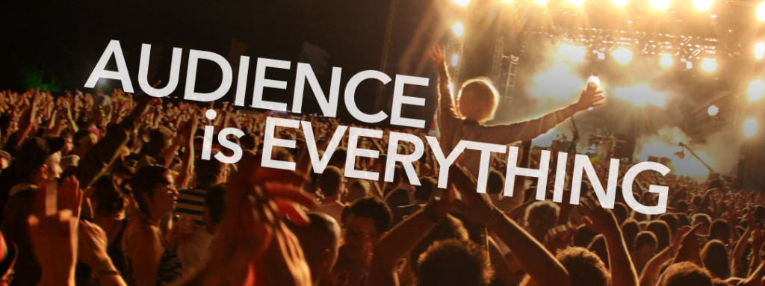
Know your Audience
If you don’t know, just ask
Notes:
Maybe create a slide for each bullet and add one photo
SXSW
Great networking and advertising for future events
FLF
It was a great (rather long) event
Definitely inspirational for young audience
It was good to bring industry veterans to show accomplishments and life in IEEE
It was also great to bring young successful Members to share their more relatable knowledge/experience with the young
Creative networking event that forced people to interact with each other. Made a lot of friends that way
Successful IEEE N3XT in Austin. Over 150 attendees
Strong Young Professionals and Student presence
It had 3 tracks. It was short and sweet
Had a Young Professionals reception right after, which was packed
Drove membership and volunteering opportunities
Lots of students
Started Monthly Networking events
About 15-20 attendees
They all liked the event!
They came to discover volunteering and networking opportunities
They liked the format and the time (Tuesday evening)
Gonna try new sponsors for every monthly event to keep things fresh
To attract newcomers and retain existing audience
Takeaways
To come prepared with contacts amongst other societies for networking
To come prepared with events they can volunteer for
To come prepared with flyers/cards for all the above

Slide 14
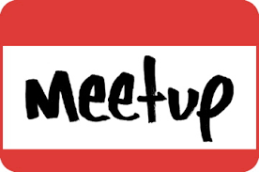
Know where your audience is
If you don’t know, just ask
Notes:
Maybe create a slide for each bullet and add one photo
SXSW
Great networking and advertising for future events
FLF
It was a great (rather long) event
Definitely inspirational for young audience
It was good to bring industry veterans to show accomplishments and life in IEEE
It was also great to bring young successful Members to share their more relatable knowledge/experience with the young
Creative networking event that forced people to interact with each other. Made a lot of friends that way
Successful IEEE N3XT in Austin. Over 150 attendees
Strong Young Professionals and Student presence
It had 3 tracks. It was short and sweet
Had a Young Professionals reception right after, which was packed
Drove membership and volunteering opportunities
Lots of students
Started Monthly Networking events
About 15-20 attendees
They all liked the event!
They came to discover volunteering and networking opportunities
They liked the format and the time (Tuesday evening)
Gonna try new sponsors for every monthly event to keep things fresh
To attract newcomers and retain existing audience
Takeaways
To come prepared with contacts amongst other societies for networking
To come prepared with events they can volunteer for
To come prepared with flyers/cards for all the above

Slide 15
Engage and Cross Promote Channels
Including Email
Notes:
Maybe create a slide for each bullet and add one photo
SXSW
Great networking and advertising for future events
FLF
It was a great (rather long) event
Definitely inspirational for young audience
It was good to bring industry veterans to show accomplishments and life in IEEE
It was also great to bring young successful Members to share their more relatable knowledge/experience with the young
Creative networking event that forced people to interact with each other. Made a lot of friends that way
Successful IEEE N3XT in Austin. Over 150 attendees
Strong Young Professionals and Student presence
It had 3 tracks. It was short and sweet
Had a Young Professionals reception right after, which was packed
Drove membership and volunteering opportunities
Lots of students
Started Monthly Networking events
About 15-20 attendees
They all liked the event!
They came to discover volunteering and networking opportunities
They liked the format and the time (Tuesday evening)
Gonna try new sponsors for every monthly event to keep things fresh
To attract newcomers and retain existing audience
Takeaways
To come prepared with contacts amongst other societies for networking
To come prepared with events they can volunteer for
To come prepared with flyers/cards for all the above

Slide 16
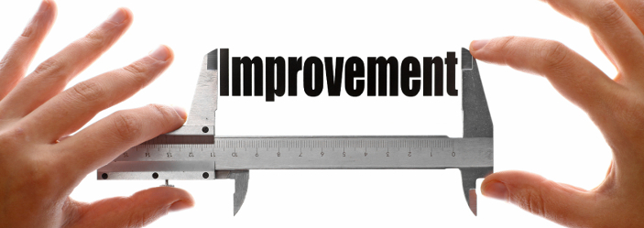
Measure & Learn
Notes:
Maybe create a slide for each bullet and add one photo
SXSW
Great networking and advertising for future events
FLF
It was a great (rather long) event
Definitely inspirational for young audience
It was good to bring industry veterans to show accomplishments and life in IEEE
It was also great to bring young successful Members to share their more relatable knowledge/experience with the young
Creative networking event that forced people to interact with each other. Made a lot of friends that way
Successful IEEE N3XT in Austin. Over 150 attendees
Strong Young Professionals and Student presence
It had 3 tracks. It was short and sweet
Had a Young Professionals reception right after, which was packed
Drove membership and volunteering opportunities
Lots of students
Started Monthly Networking events
About 15-20 attendees
They all liked the event!
They came to discover volunteering and networking opportunities
They liked the format and the time (Tuesday evening)
Gonna try new sponsors for every monthly event to keep things fresh
To attract newcomers and retain existing audience
Takeaways
To come prepared with contacts amongst other societies for networking
To come prepared with events they can volunteer for
To come prepared with flyers/cards for all the above

Slide 17
Build, Measure, Learn. Repeat
Notes:
Maybe create a slide for each bullet and add one photo
SXSW
Great networking and advertising for future events
FLF
It was a great (rather long) event
Definitely inspirational for young audience
It was good to bring industry veterans to show accomplishments and life in IEEE
It was also great to bring young successful Members to share their more relatable knowledge/experience with the young
Creative networking event that forced people to interact with each other. Made a lot of friends that way
Successful IEEE N3XT in Austin. Over 150 attendees
Strong Young Professionals and Student presence
It had 3 tracks. It was short and sweet
Had a Young Professionals reception right after, which was packed
Drove membership and volunteering opportunities
Lots of students
Started Monthly Networking events
About 15-20 attendees
They all liked the event!
They came to discover volunteering and networking opportunities
They liked the format and the time (Tuesday evening)
Gonna try new sponsors for every monthly event to keep things fresh
To attract newcomers and retain existing audience
Takeaways
To come prepared with contacts amongst other societies for networking
To come prepared with events they can volunteer for
To come prepared with flyers/cards for all the above

Slide 18
Notes:
Maybe create a slide for each bullet and add one photo
SXSW
Great networking and advertising for future events
FLF
It was a great (rather long) event
Definitely inspirational for young audience
It was good to bring industry veterans to show accomplishments and life in IEEE
It was also great to bring young successful Members to share their more relatable knowledge/experience with the young
Creative networking event that forced people to interact with each other. Made a lot of friends that way
Successful IEEE N3XT in Austin. Over 150 attendees
Strong Young Professionals and Student presence
It had 3 tracks. It was short and sweet
Had a Young Professionals reception right after, which was packed
Drove membership and volunteering opportunities
Lots of students
Started Monthly Networking events
About 15-20 attendees
They all liked the event!
They came to discover volunteering and networking opportunities
They liked the format and the time (Tuesday evening)
Gonna try new sponsors for every monthly event to keep things fresh
To attract newcomers and retain existing audience
Takeaways
To come prepared with contacts amongst other societies for networking
To come prepared with events they can volunteer for
To come prepared with flyers/cards for all the above

Slide 19
What I need from You
For each Society, I need access
Social Media Accounts (if any)
LinkedIn group (if any)
Email distribution list

Slide 20
Key Takeaways
Audience is everything
Know your audience
Build, Measure, Learn, & Repeat
Monthly Networking meetings
Social Media engagements
Be consistent but keep things fresh
New activities/sponsors for repeating events
Automate
Emails
Social Media

Slide 21
Questions
Follow us on:
bit.ly/yp-ctx
bit.ly/yp-ctx-twitter
bit.ly/yp-ctx-linkedin
bit.ly/yp-ctx-slack
bit.ly/yp-ctx-email
@fabiogomez on Slack
fabio.gomez@ieee.org

